Slide 1

HOUSING PRICE PREDICTION PRESENTATION
Prepared by Sonali Daga

Slide 2
Agenda:
Introduction
Problem Statement
Objective
Exploratory Data Analysis (EDA)
Visualization
Inference
Future Work

Slide 3
INTRODUCTION
PROBLEM STATEMENT:
Houses are one of the necessary need of each and every person around the globe and therefore housing and real estate market is one of the markets which is one of the major contributors in the world’s economy. It is a very large market and there are various companies working in the domain. Data science comes as a very important tool to solve problems in the domain to help the companies increase their overall revenue, profits, improving their marketing strategies and focusing on changing trends in house sales and purchases. Predictive modelling, Market mix modelling, recommendation systems are some of the machine learning techniques used for achieving the business goals for housing companies. Our problem is related to one such housing company. A US-based housing company named Surprise Housing has decided to enter the Australian market. The company uses data analytics to purchase houses at a price below their actual values and flip them at a higher price. For the same purpose, the company has collected a data set from the sale of houses in Australia. The data is provided in the CSV file below.

Slide 4
The company is looking at prospective properties to buy houses to enter the market. You are required to build a model using Machine Learning in order to predict the actual value of the prospective properties and decide whether to invest in them or not. For this company wants to know:
1. Which variables are important to predict the price of variable?
2. How do these variables describe the price of the house?
Business Goal:
You are required to model the price of houses with the available independent variables. This model will then be used by the management to understand how exactly the prices vary with the variables. They can accordingly manipulate the strategy of the firm and concentrate on areas that will yield high returns. Further, the model will be a good way for the management to understand the pricing dynamics of a new market.

Slide 5
EDA(Exploratory Data Analysis)

Slide 6
Data Description
The dataset contains 1460 records (rows) and 81 features (columns).
Here, we will provide a brief description of dataset features. Since the number of features is large (81), we will attach the original data description file to this study for more information about the dataset. Now, we will mention the feature name with a short description of its meaning.

Slide 7
Data frame Description:
The dataset contains the data of the house. On the basis of the data we have to predict the sale price of the house, the datset contains the data like, 'Id', 'MSSubClass', 'MSZoning', 'LotFrontage', 'LotArea', 'Street', 'Alley', 'LotShape', 'LandContour', 'Utilities', 'LotConfig', 'LandSlope', 'Neighborhood', 'Condition1', 'Condition2', 'BldgType', 'HouseStyle', 'OverallQual', 'OverallCond', 'YearBuilt', 'YearRemodAdd', 'RoofStyle', 'RoofMatl', 'Exterior1st', 'Exterior2nd', 'MasVnrType', 'MasVnrArea', 'ExterQual', 'ExterCond', 'Foundation', 'BsmtQual', 'BsmtCond', 'BsmtExposure', 'BsmtFinType1', 'BsmtFinSF1', 'BsmtFinType2', 'BsmtFinSF2', 'BsmtUnfSF', 'TotalBsmtSF', 'Heating', 'HeatingQC', 'CentralAir', 'Electrical', '1stFlrSF', '2ndFlrSF', 'LowQualFinSF', 'GrLivArea', 'BsmtFullBath', 'BsmtHalfBath', 'FullBath', 'HalfBath', 'BedroomAbvGr', 'KitchenAbvGr', 'KitchenQual', 'TotRmsAbvGrd', 'Functional', 'Fireplaces', 'FireplaceQu', 'GarageType', 'GarageYrBlt', 'GarageFinish', 'GarageCars', 'GarageArea', 'GarageQual', 'GarageCond', 'PavedDrive', 'WoodDeckSF', 'OpenPorchSF', 'EnclosedPorch', '3SsnPorch', 'ScreenPorch', 'PoolArea','PoolQC', 'Fence', 'MiscFeature', 'MiscVal', 'MoSold', 'YrSold', 'SaleType', 'SaleCondition', 'SalePrice'.

Slide 8
Target Variable
Sale Price : It’s continuous type of data, so the model approach is carried out for Regression analysis.
Regression:
It’s an analysis is used when you want to predict a continuous dependent variable from a number of independent variables.
Independent variables with more than two levels can also be used in regression analysis.

Slide 9
Visualization

Slide 10
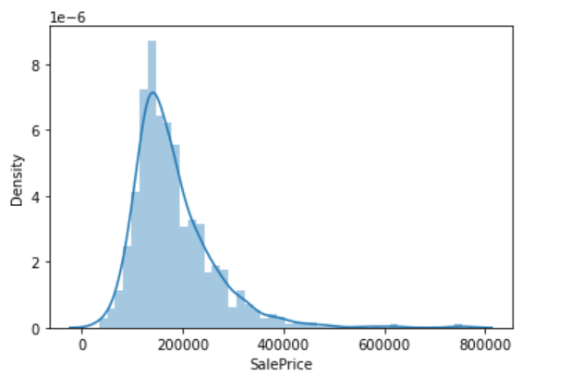
Target Variable (Sale Price Distribution)

Slide 11
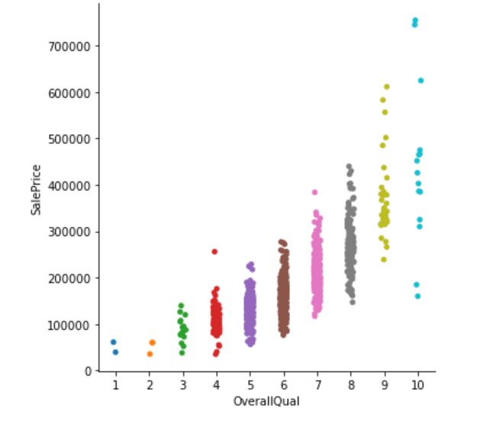
Cat plot Distribution for Overall Qualification vs Sale Price(Target Variable)

Slide 12
Column Dropped
The columns that are going to be drop are Utilities. They are strings , cannot be categorized and don’t contribute much to the outcome.

Slide 13
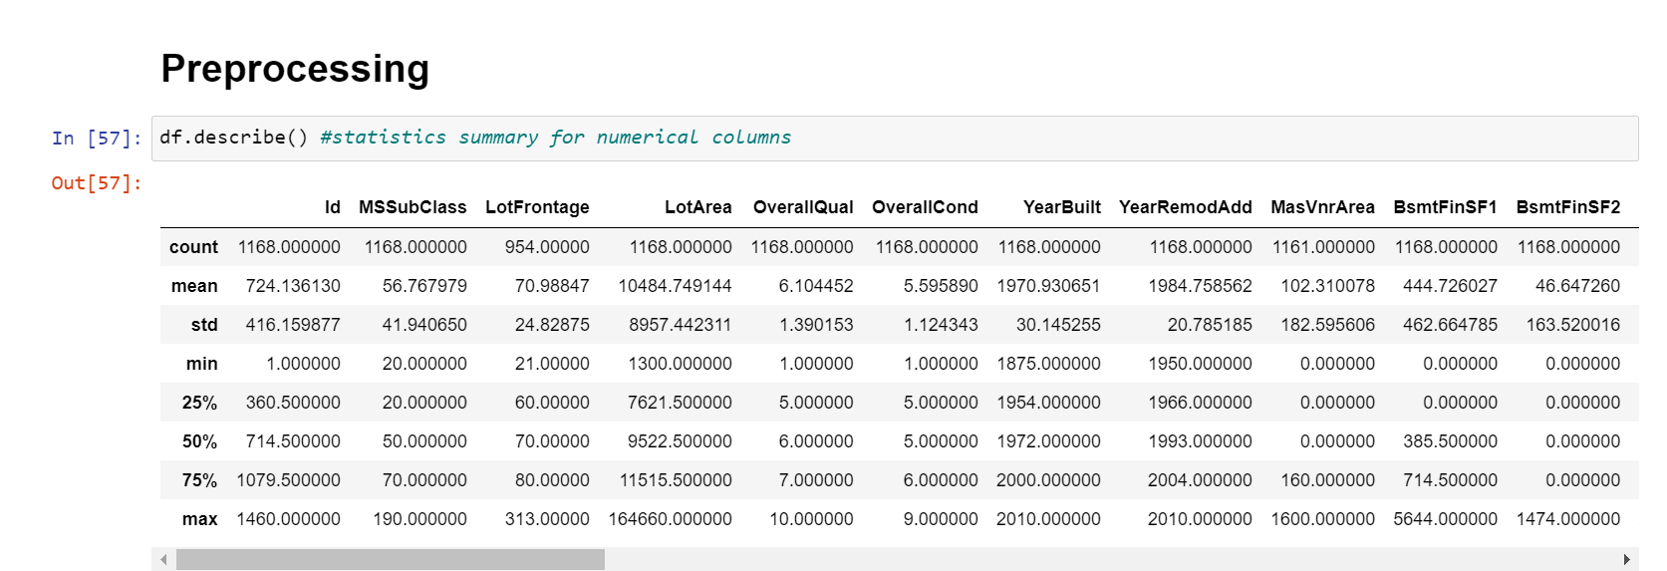
Data Pre-processing

Slide 14
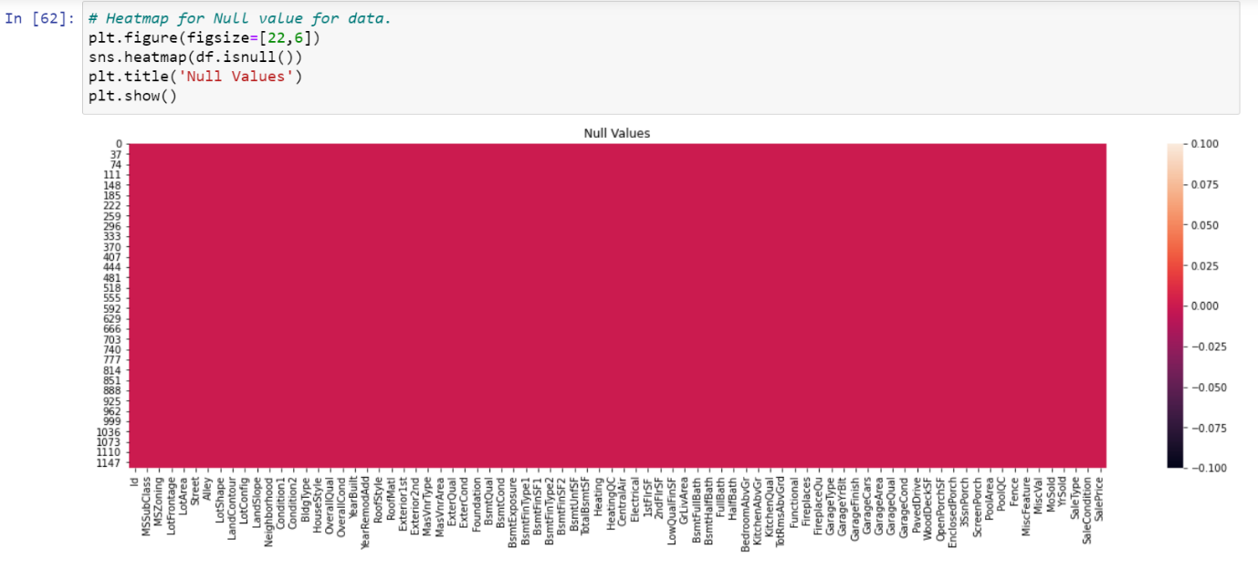
Data Cleaning
Dealing with Missing Values:
Filling the missing values using fillna method.
Check if there is any remaining missing value in our dataset
To show graphical representation of null using heatmap for entire dataset:

Slide 15
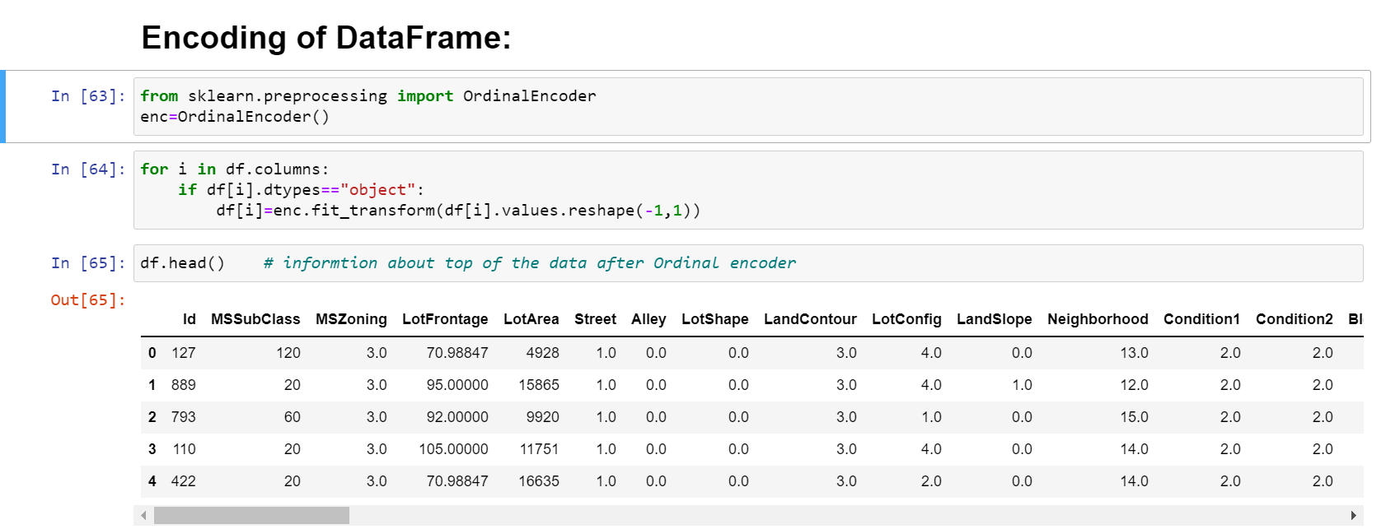
Encoding of Data Frame:
Since the dataset has a lot string values. We will use the ordinal encoding techniques to convert the string data to numerical one.

Slide 16
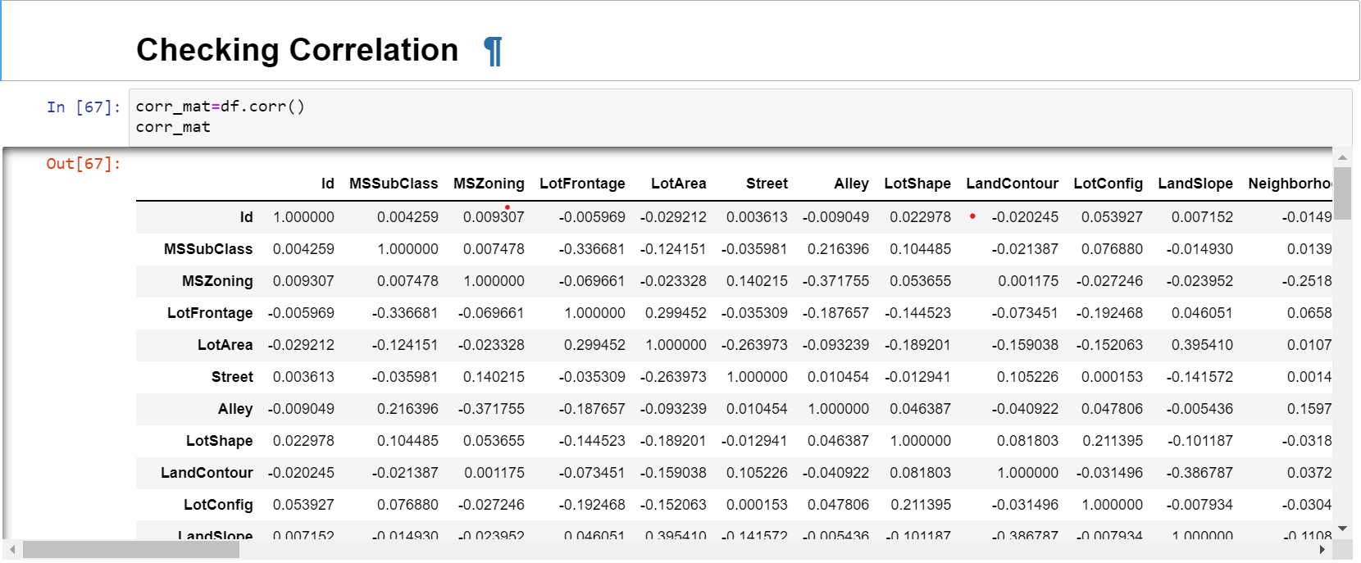
Correlation matrix:
A correlation matrix is simply a table which displays the correlation. The measure is best used in variables that demonstrate a linear relationship between each other. The fit of the data can be visually represented in a heatmap.

Slide 17
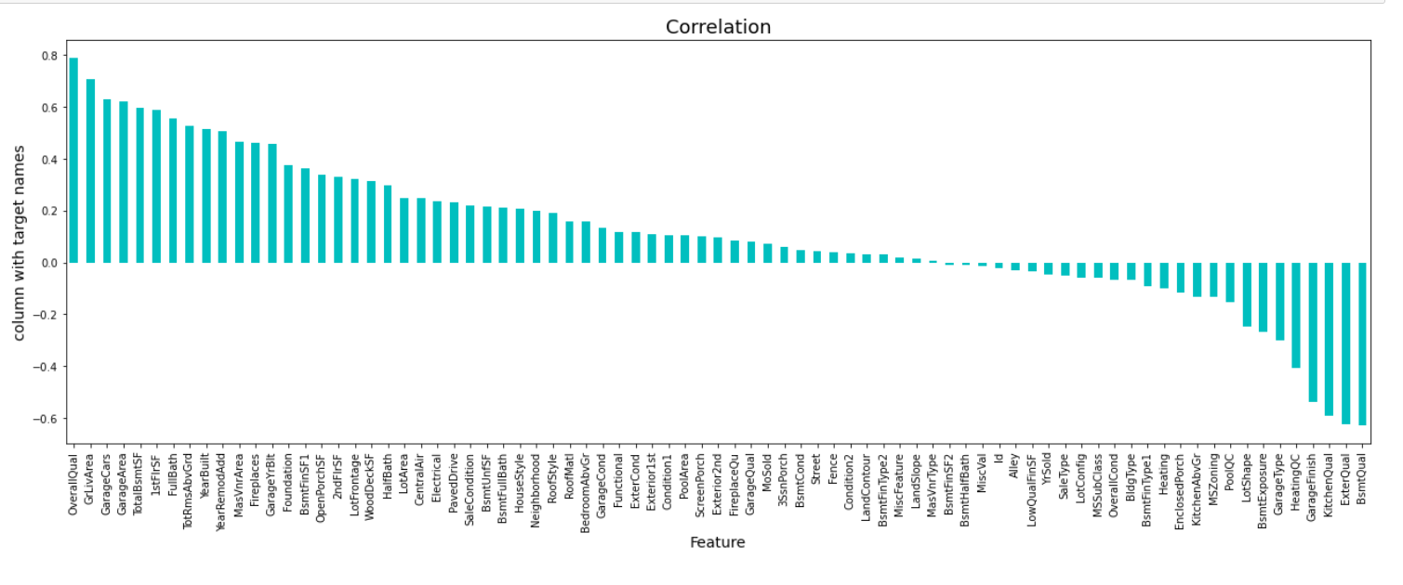
Checking the columns which are positively and negative correlated with the target columns:

Slide 18
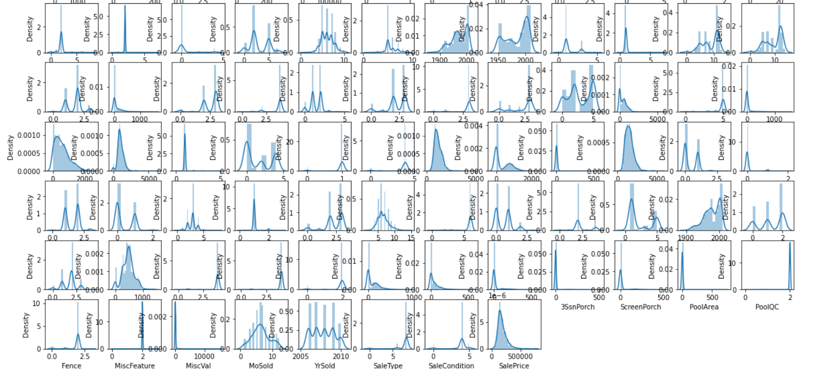
Check the data distribution among all the columns.

Slide 19
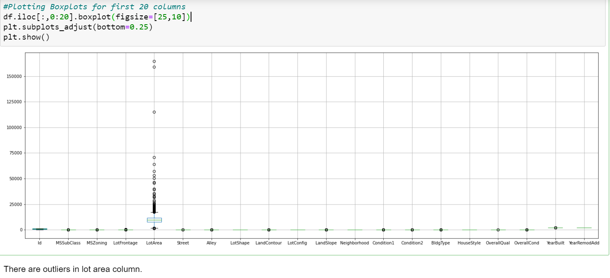
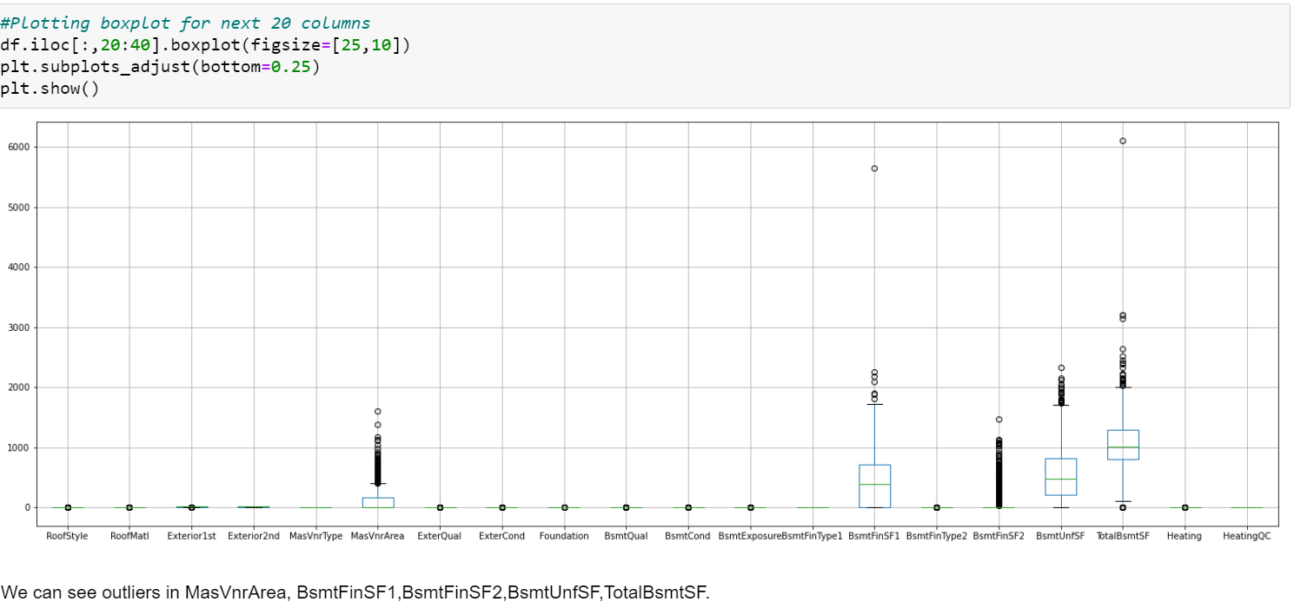
Outliers Check: There are 80 columns in dataset so it’s not possible to plot each and every column separately or plot all together. so, we will print in 4 steps:
First set
Second set

Slide 20
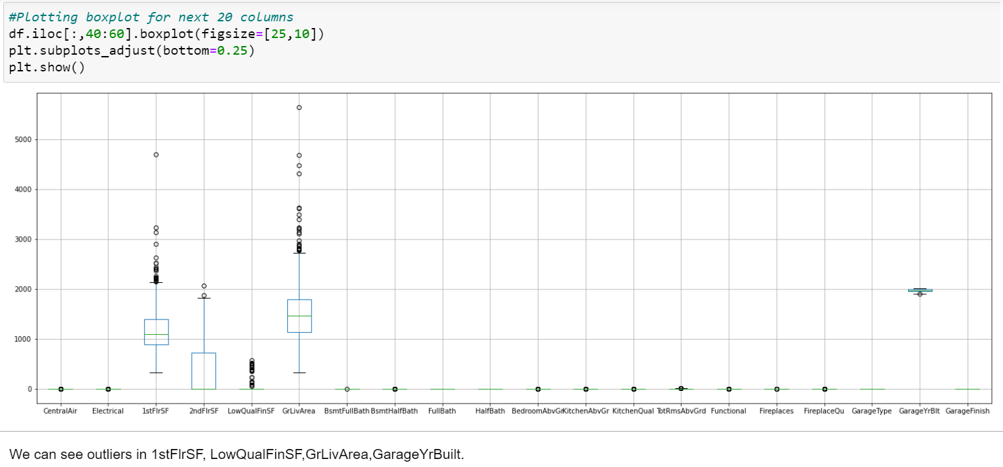
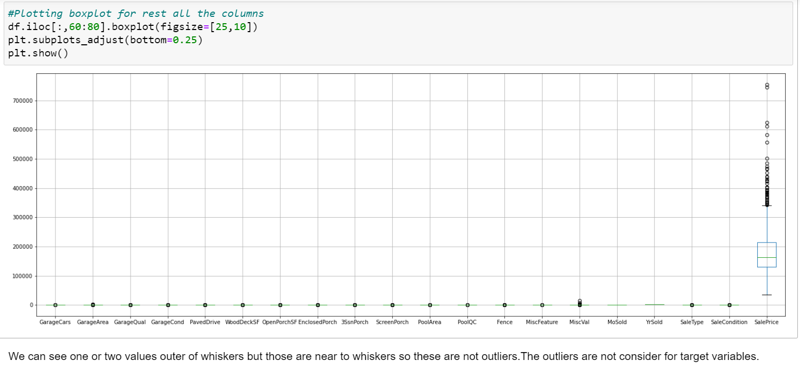
Remaining section of Outliers Check:
Third set
Fourth set

Slide 21
Checking Skewness: Now here, we are going to use Power transform function to handle skewness in dataset
Before handling Skewness
After handling Skewness
Columns Skewness | Columns Skewness
Id 0.026526 | CentralAir -3.475188
MSSubClass 1.422019 | Electrical -3.104209
MSZoning -1.796785 | 1stFlrSF 1.513707
LotFrontage 2.710383 | 2ndFlrSF 0.823479
LotArea 10.659285 | LowQualFinSF 8.666142
Street -17.021969 | GrLivArea 1.449952
Alley 5.436187 | BsmtFullBath 0.627106
LotShape -0.603775 | BsmtHalfBath 4.264403
LandContour -3.125982 | FullBath 0.057809
LotConfig -1.118821 | HalfBath 0.656492
LandSlope 4.812568 | BedroomAbvGr 0.243855
Neighborhood 0.043735 | KitchenAbvGr 4.365259
Condition1 3.008289 | KitchenQual -1.408106
Condition2 11.514458 | TotRmsAbvGrd 0.644657
BldgType 2.318657 | Functional -3.999663
HouseStyle 0.285680 | Fireplaces 0.671966
OverallQual 0.175082 | FireplaceQu 0.753507
OverallCond 0.580714 | GarageType 0.831142
YearBuilt -0.579204 | GarageYrBlt -0.662934
YearRemodAdd -0.495864 | GarageFinish -0.450190
RoofStyle 1.498560 | GarageCars -0.358556
RoofMatl 7.577352 | GarageArea 0.189665
Exterior1st -0.612816 | GarageQual -4.582386
Exterior2nd -0.592349 | GarageCond -5.422472
MasVnrType -0.104609 | PavedDrive -3.274035
MasVnrArea 2.834658 | WoodDeckSF 1.504929
ExterQual -1.810843 | OpenPorchSF 2.410840
ExterCond -2.516219 | EnclosedPorch 3.043610
Foundation -0.002761 | 3SsnPorch 9.770611
BsmtQual -1.343781 | ScreenPorch 4.105741
BsmtCond -3.293554 | PoolArea 13.243711
BsmtExposure -1.166987 | PoolQC -19.401558
BsmtFinType1 -0.068901 | Fence -3.185107
BsmtFinSF1 1.871606 | MiscFeature -17.238424
BsmtFinType2 -3.615783 | MiscVal 23.065943
BsmtFinSF2 4.365829 | MoSold 0.220979
BsmtUnfSF 0.909057 | YrSold 0.115765
TotalBsmtSF 1.744591 | SaleType -3.660513
Heating 10.103609 | SaleCondition -2.671829
HeatingQC 0.449933 | SalePrice 1.953878
Columns Skewness | Columns Skewness
Id -0.268486 | CentralAir -3.475188
MSSubClass 0.064007 | Electrical -3.006845
MSZoning 0.233113 | 1stFlrSF -0.002391
LotFrontage 0.161368 | 2ndFlrSF 0.280208
LotArea 0.032509 | LowQualFinSF 6.922843
Street -17.021969 | GrLivArea -0.000054
Alley 5.436187 | BsmtFullBath 0.365488
LotShape -0.594207 | BsmtHalfBath 3.954345
LandContour -2.592303 | FullBath -0.045944
LotConfig -1.030401 | HalfBath 0.498003
LandSlope 3.954345 | BedroomAbvGr 0.116498
Neighborhood -0.146541 | KitchenAbvGr -2.370593
Condition1 0.225468 | KitchenQual -0.435558
Condition2 0.537277 | TotRmsAbvGrd 0.002332
BldgType 1.857194 | Functional -3.343664
HouseStyle -0.080331 | Fireplaces 0.084950
OverallQual 0.021658 | FireplaceQu 0.082653
OverallCond 0.048063 | GarageType 0.222501
YearBuilt -0.126641 | GarageYrBlt -0.132523
YearRemodAdd -0.225131 | GarageFinish -0.335248
RoofStyle -0.292233 | GarageCars -0.022970
RoofMatl -6.314987 | GarageArea -0.320370
Exterior1st -0.338023 | GarageQual -4.327379
Exterior2nd -0.352793 | GarageCond -4.925781
MasVnrType -0.016203 | PavedDrive -3.025809
MasVnrArea 0.416370 | WoodDeckSF 0.113026
ExterQual -0.605112 | OpenPorchSF -0.002749
ExterCond -2.270791 | EnclosedPorch 2.022616
Foundation 0.004296 | 3SsnPorch 7.087955
BsmtQual -0.413999 | ScreenPorch 3.067153
BsmtCond -3.025865 | PoolArea 12.817372
BsmtExposure -0.914214 | PoolQC -17.021969
BsmtFinType1 -0.206639 | Fence 1.116688
BsmtFinSF1 -0.404528 | MiscFeature 9.291637
BsmtFinType2 -2.420885 | MiscVal 4.991071
BsmtFinSF2 2.394737 | MoSold -0.035838
BsmtUnfSF -0.284390 | YrSold 0.112893
TotalBsmtSF 0.286779 | SaleType -2.067563
Heating -4.541694 | SaleCondition -0.353292
HeatingQC 0.156511

Slide 22
Model Building and Evaluation
These are modelling approach made to build an model :
Linear
Random Forest
Decision Tree
XGBoost
k-nearest neighbors (KNN)

Slide 23
The Predict test and train values
Predict Test
Predict Train
Linear = 82.14
Random Forest = 88.85
Decision Tree = 77.5
XGBoost = 89.23
k-nearest neighbors = 81.81
Linear = 83.17
Random Forest = 97.38
Decision Tree = 100
XGBoost = 99.99
k-nearest neighbors = 81.60

Slide 24
Hyper Parameter Tuning
The Hyper parameter tuning is carried out for both Random Forest and XGBoost.
Because both predict test value is similar i.e. 89.

Slide 25
Hyper Parameter Tuning Performance
Random Forest Regressor:
XGBoost Regressor:
R2 Score = 86.79
Cross validation Score = 84.68
R2 Score = 89.15
Cross validation Score = 86.55

Slide 26
Best Model
Hyper parameter Tuning performance is compared for both Random Forest and XGBoost Hyper parameter Tuning i.e.,R2 score = 86.79 and 89.15 respectively. Finally, XGBoost has better R2 score.so this is our best model for these dataset.

Slide 27
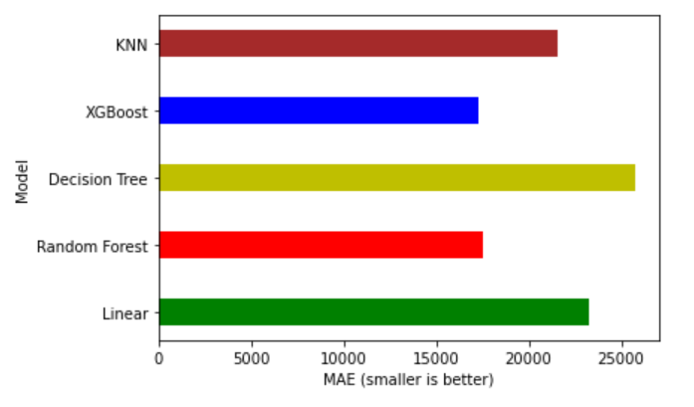
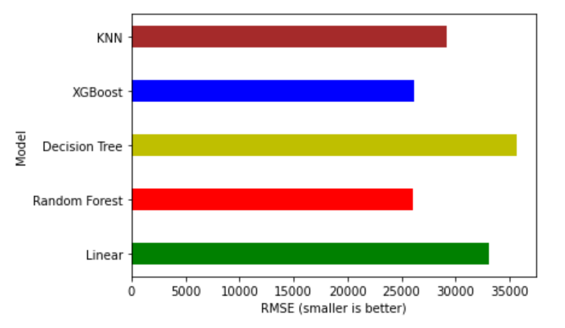
Performance Interpretation:
MAE (Mean Absolute Error)
RMSE (Root Mean Squared Error)

Slide 28
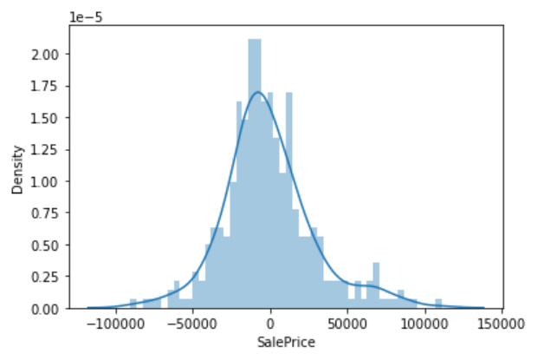
Notice here that our residuals looked to be normally distributed and that's really a good sign which means that our model was a correct choice for the data.
From these plots above, we can understand the distribution of Sale Price.
Finally, we came to know that our best model is both XGBoost and the worst model is Decision Tree.

Slide 29
Feature Importance’s:
Some of the models we used provide the ability to see the importance of each feature in the dataset after fitting the model. We will look at the feature importance’s provided by both Random Forest and XGBoost models. We have 81 features in our data which is a big number, so we will take a look at the 15 most important features.

Slide 30
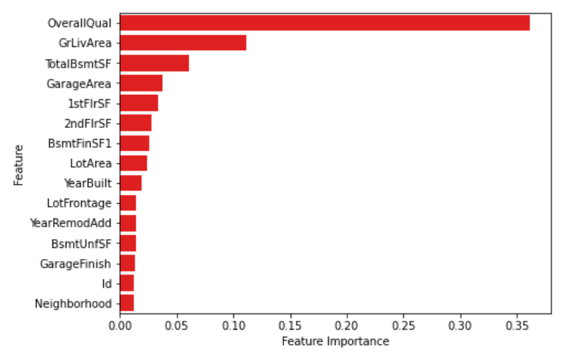
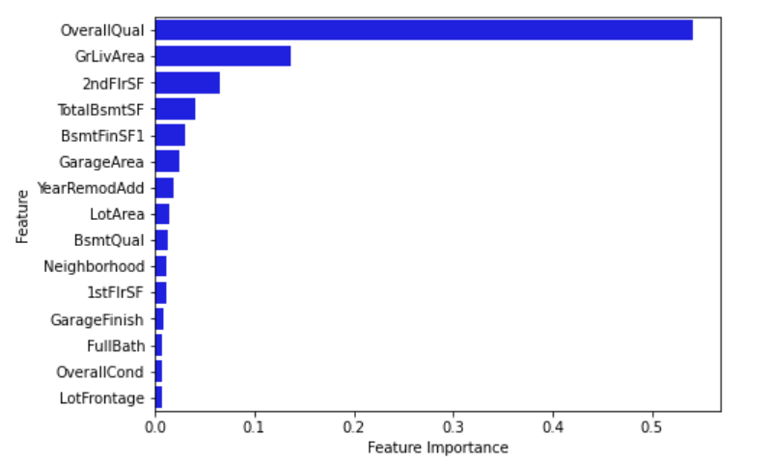
Feature Importance’s:
Random Forest
XGBoost

Slide 31
Common Important Features:
Now, let us see which features are among the most important features for both XGBoost and Random Forest models, and let's find out the difference in their importance regarding the two models:

Slide 32
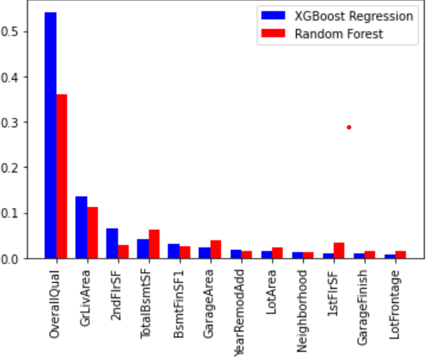
Common Important Features:

Slide 33
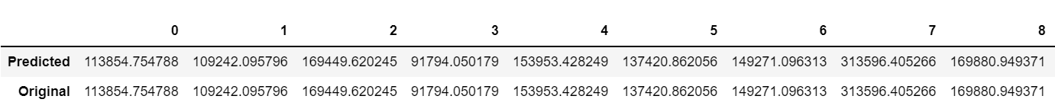
Conclusion
In this paper, we built several regression models to predict the price of some house given some of the house features. We evaluated and compared each model to determine the one with highest performance. We also looked at how some models rank the features according to their importance. In this paper, we followed the data science process starting with getting the data, then cleaning and pre-processing the data, followed by exploring the data and building models, then evaluating the results and communicating them with visualizations.
As a recommendation, we advise to use this model (or a version of it trained with more recent data) by people who want to buy a house in the area covered by the dataset to have an idea about the actual price. The model can be used also with datasets that covered areas provided that they contain the same features. We also suggest that people take into consideration the features that were deemed as most important as seen in the previous section; this might help them estimate the house price better.

Slide 34


